Slide 1
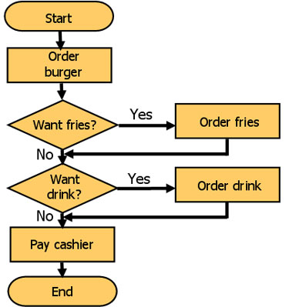
WHAT IS A FLOWCHART ?
A flowchart is a formalized graphic representation of a logic sequence. The purpose of a flowchart is to provide people with a common language or reference point when dealing with a project or process. You can also use them to define and analyze a process, build a step-by-step picture of it, and then standardize or improve it. Each step is represented by a symbol and connecting lines show the step-by-step progression through the task.
Figure 1

Slide 2
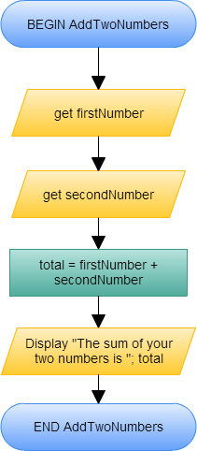
Sequence ?
In a computer program or an algorithm, sequence involves simple steps which are to be executed one after the other. The steps are executed in the same order in which they are written.
Have a look at the example on the right. Set of instructions to add two numbers and display the answer.
Figure 2

Slide 3
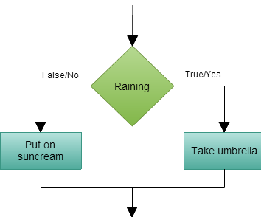
Selection ?
Selection is used in a computer program or an algorithm to determine which particular step or set of steps is to be executed. You can give conditions that can be used when choosing specific paths depending on possibilities.
Here is an example of a selection on what you would do during a rainy day and a one that’s not.
Figure 3

Slide 4
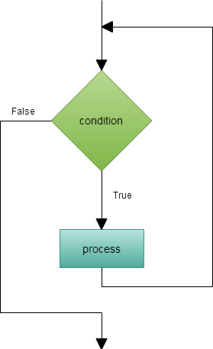
Repetition ?
Repetition allows for a portion of an algorithm or computer program to be executed any number of times dependent on some condition being met. An occurrence of repetition is usually known as a loop. Each of these loops have a termination condition that stops the repetition.
Here is an example for a repetition or a loop.
Figure 4

